Slide 1
B-Tree Index Structure

Slide 2

End-User View
Create Table R (
Id Number,
name varchar2(100),
…);
Select ID, name
From R
Where ID = 101;
Select ID, name
From R
Where name = ‘Mike’;
To speedup queries ➔ We create indexes
> Create Index R_ID on R (ID);
> Create Index R_Name on R (name);

Slide 3
Alternative Tree Index Structures
ISAM (Indexed Sequential Access Method):
  Static structure
B+ tree:
  Dynamic structure
  Adjust gracefully under inserts and deletes.

Slide 4
ISAM Index
k1
k2
kN
Index File
Page 1
Page 2
Page 3
Page N
Data File
index entry
P
K
P
K
P
K
P
m
0
1
1
2
2
m
Notes:
3

Slide 5
ISAM
Index file may still be quite large.
But we can apply the idea repeatedly!
Non-leaf
Pages
Leaf
Pages
Overflow
page
Primary pages
Only leaf pages contain data entries.
Notes:
4

Slide 6
Example ISAM Tree
Each node can hold 2 entries.
No need for `next-leaf-page’ pointers.
Root
40
20
33
51
63
10*
15*
20*
27*
33*
37*
40*
46*
51*
55*
63*
97*
Notes:
6

Slide 7
Inserting 23*, 48*, 41*, 42* ...
Root
40
20
33
51
63
10*
15*
20*
27*
33*
37*
40*
46*
51*
55*
63*
97*
Notes:
6

Slide 8
After Inserting 23*, 48*, 41*...
Root
Index
40
Pages
20
33
51
63
Primary
Leaf
10*
15*
20*
27*
33*
37*
40*
46*
51*
55*
63*
97*
Pages
Overflow
23*
48*
41*
Pages
Notes:
7

Slide 9
After Inserting 23*, 48*, 41*, 42* ...
Root
Index
40
Pages
20
33
51
63
Primary
Leaf
10*
15*
20*
27*
33*
37*
40*
46*
51*
55*
63*
97*
Pages
Overflow
23*
48*
41*
Pages
42*
Notes:
7

Slide 10
Now Let’s Delete: 42*, 51*, 97*, …
Root
Index
40
Pages
20
33
51
63
Primary
Leaf
10*
15*
20*
27*
33*
37*
40*
46*
51*
55*
63*
97*
Pages
Overflow
23*
48*
41*
Pages
42*
Notes:
7

Slide 11
... After Deleting 42*, 51*, 97*
Root
40
20
33
51
63
10*
15*
20*
27*
33*
37*
40*
46*
55*
63*
23*
48*
41*
Note that 51* appears in index levels, but not in leaf!
Index still is “fully balanced”, but with many empty slots.
Notes:
8

Slide 12
Comments on ISAM
Data Pages
Index Pages
Overflow pages
Notes:
5

Slide 13
Comments on ISAM
Data Pages
Index Pages
File creation:
- leaf (data) pages allocated sequentially
- sorted by search key
- index pages allocated
- space for overflow pages later created
Index entries: <search key value, page id>;
they `direct’ search for data entries,
which are in leaf pages or even in overflow pages.
Overflow pages
Notes:
5

Slide 14
Comments on ISAM
Data Pages
Index Pages
Overflow pages
Search:
  Start at root; use key comparisons to go to leaf.
Insert:
  Find leaf that data entry belongs to, and put it there.
Delete:
  Find and remove from leaf; if empty overflow page,
de-allocate. If empty primary page, leave it.
Notes:
5

Slide 15
Comments on ISAM : Pros? Cons?
Main idea:
Static tree structure: inserts/deletes affect only leaf pages.
Cons:
Long overflow chains may appear.
May affect retrieve performance.
Keep 20% free in leaf page.
Problem might still appear!
Pros :
+ Concurrent access.
Index page is not locked since it is never changed.
Question : What could we do to improve this ?

Slide 16
B+ Tree: Most Widely Used Index
Guarantee Search/Insert/delete at log _{F} N cost
with F = fanout, N = # leaf pages
Keeps tree height-balanced.
Supports equality searches efficiently.
Supports range-searches efficiently.
Index Entries
(Direct search)
Data Entries
("Sequence set")
Notes:
9

Slide 17
What Is B-Tree
A disk-based multi-level balanced tree index structure
Each node in the tree is a disk page ➔ Has to fit in one disk page
The pointers are locations on disk either block Ids or record Ids
Root
13
17
24
30
2*
3*
5*
7*
14*
16*
19*
20*
22*
24*
27*
29*
33*
34*
38*
39*

Slide 18
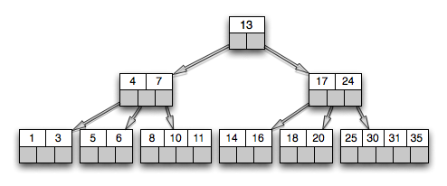
What Is B-Tree
A disk-based multi-level balanced tree index structure
Has one root (can be the only level)
The height of the tree grows and shrinks dynamically as needed
We always (in search, insert, delete) start from the root and move down one level at a time
One root
Internal nodes (can be many levels)
Leaf nodes (one leaf level)

Slide 19
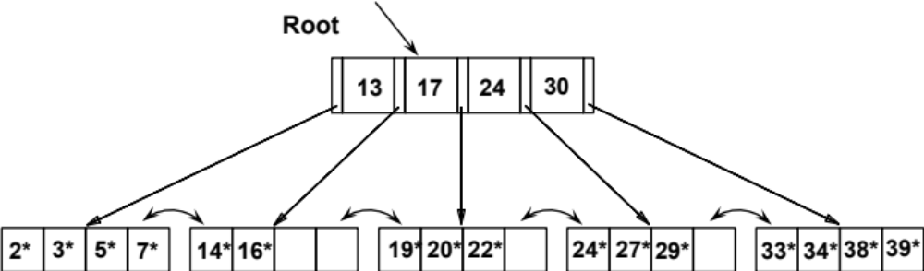
What Is B-Tree
A disk-based multi-level balanced tree index structure
All leaf nodes are at the same height
Height 2
Height 3

Slide 20

B-Tree Characteristics
Each node holds N keys & N+1 pointers
Keys in any node are sorted (left to right)
Each node is at least 50% full (Minimum 50% occupancy)
  Except the Root can have as minimum (1 key & 2 pointers)
No spaces in the middle
Number of pointers in any node (even not full) = number of keys + 1
  The rest are Null
N = 4

Slide 21
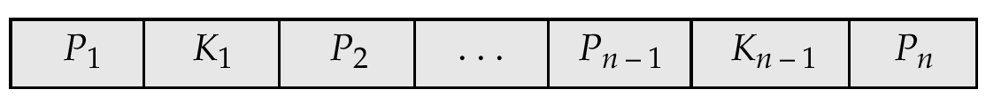
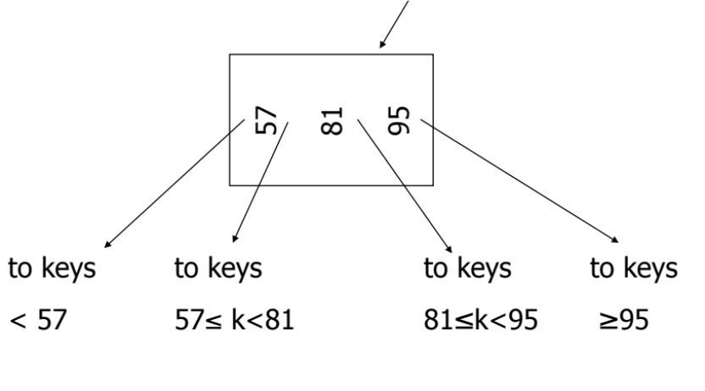
B⁺-Tree Non-Leaf Node Structure
Pointers to next level
(These are N+1 pointers)
k< 13
17≤k<24
24≤k<30
k>=30
13≤k<17

Slide 22
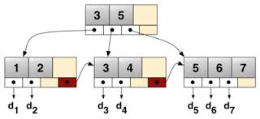
B⁺-Tree Leaf Node Structure
57
81
95
Pointer to next leaf node on right
To record
with key 57
To record
with key 95
To record
with key 81
These are the leaf nodes
< 13
17≤k<24
24≤k<30
30≤k
13≤k<17

Slide 23
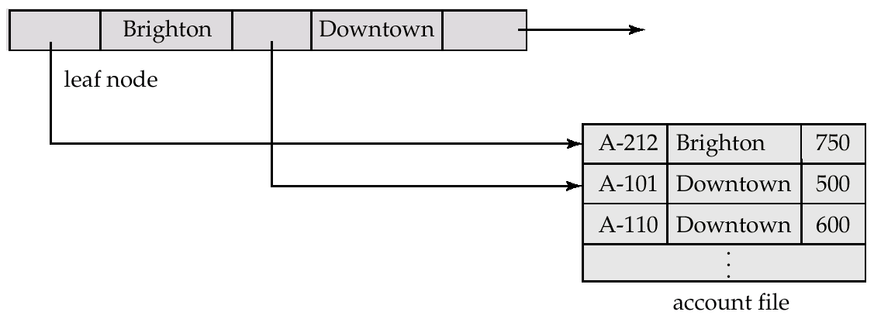
Leaf Nodes in B-Tree
Properties of a leaf node:
For each entry i in a leaf node:
  pointer P_{i} points to a file record with search-key value K_{i}.
P_{n} points to next leaf node in search-key order

Slide 24
Good Utilization
B-tree nodes should not be too empty
Each node is at least 50% full (Minimum 50% occupancy)
  Except the Root can have as minimum (1 key & 2 pointers)
Use at least
  Non-leaf: ⎡(n+1)/2⎤ pointers
  Leaf: ⎣(n+1)/2⎦ pointers to data

Slide 25
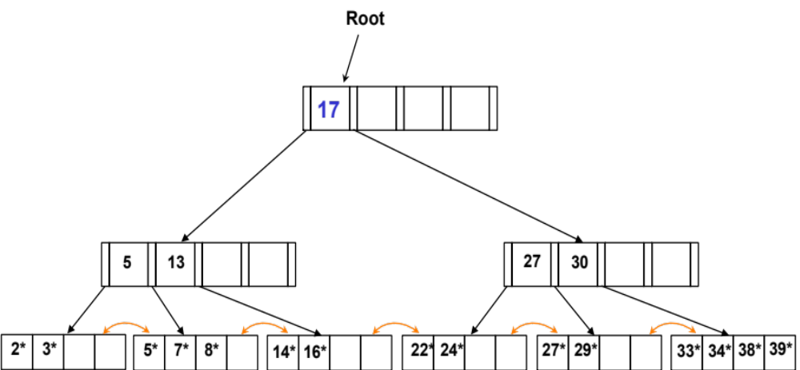

Dense vs. Sparse
Leaf level can be either dense or sparse
  Sparse only if the data file is sorted
In most DBMS, the leaf level is always dense
  One index entry for each data record
What about values in non-leaf levels
  Subset set of the leaf values
How is this internal subset selected??

Slide 26
B-trees in practice
Assume a disk block of 4KB = 4096
Assume indexing date keys (10 bytes each) & each pointer is 8 bytes
How many records can be indexed in a 3-level B-Tree index (root + 2 levels). Compute the maximum.
Each node has N keys & N+1 pointers
  10N + 8(N+1) = 4096 ➔ N = 227
A 3-Level B-Tree (root + 1st and 2nd levels): Max
  First level (root) ➔ 1 Node [Max=227 keys, 228 pointers]
  2nd level ➔ 228 Nodes [each one has max 228 pointers]
  3rd level ➔ 228² Leaf nodes [each has max 227 keys]
  So Max indexed records is = 228² x 227 records

Slide 27
B-trees in practice
Assume a disk block of 4KB = 4096
Assume indexing date keys (10 bytes each) & each pointer is 8 bytes
How many records can be indexed in a 3-level B-Tree index (root + 2 levels). Compute the minimum
Each node has N keys & N+1 pointers
  10N + 8(N+1) = 4096 ➔ N = 227
A 3-Level B-Tree (root + 1st and 2nd levels): Min
  First level (root) ➔ 1 Node [Min=1 key, 2 pointers]
  2nd level ➔ 2 Nodes [each one has min 113 key, and 114 pointers]
  3rd level ➔ 2x 114 Leaf nodes [each has min 113 keys]
  So Min indexed records is = 228 x 113 records

Slide 28
B-Tree in Practice
Usually 3- or 4-level B-tree index is enough to index even large files
The height of the tree is usually very small
  Good for searching, insertion, and deletion

Slide 29
B-Tree Querying

Slide 30
Queries on B-Trees
Equality Search: Find all records with a search-key value of k.
  Start with the root node
    Examine the keys (use binary search) until find a pointer to follow
  Repeat until reach a leaf node
  Search the keys in the leaf node for the first key = k
  Move right until hit a key larger than k (may move from one node to another node)
  Follow the pointers to the data records

Slide 31
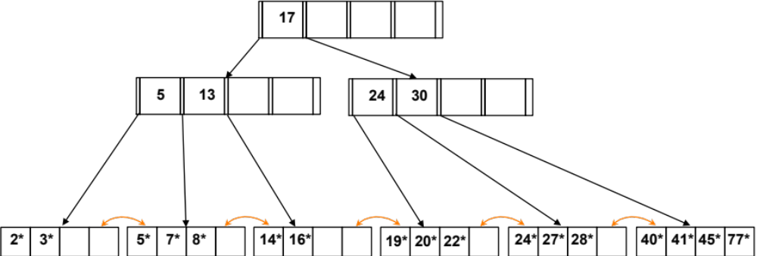
B-Tree: Equality Search
1
2
3
4
5
6
7
8
9
Find key = 0, 2, 28, 101 ?
0 ➔ N1, N2, N4
2 ➔ N1, N2, N4
28 ➔ N1, N3, N8
101 ➔ N1, N3, N9

Slide 32
Queries on B-Trees
Range Search: Find all records between [k1, k2].
  Start with the root node and search for k1
    Examine the keys (use binary search) until find a pointer to follow
  Repeat until reach a leaf node
  Search the keys in the leaf node for the first key = k1 or the first larger
  Move right until as long as the key is not larger than k2 (may move from one node to another node)
  Follow the pointers to the data records

Slide 33
B-Tree: Range Search
1
2
3
4
5
6
7
8
9
Find key in [5, 20], [4, 16], [100, 200]?
[5, 20] ➔ N1, N2, N5, N6, N7
[4, 16] ➔ N1, N2, N4, N5, N6
[100, 200] ➔ N1, N3, N9

Slide 34
B-Tree Insertion

Slide 35
Inserting a Data Entry into a B-Tree
Find correct leaf L. (Searching)
Put data entry onto L.
  If L has enough space, done!
  Else, must split L (into L and a new node L2)
    Redistribute entries evenly, copy up middle key.
    Insert index entry pointing to L2 into parent of L.
This can happen recursively
  To split index node, redistribute entries evenly, but push up middle key. (Contrast with leaf splits.)
Splits “grow” tree; root split increases height.
  Tree growth: gets wider or one level taller at top.
Notes:
6

Slide 36

Updates on B-Trees: Insertion
13
17
24
30
Insert 23
2*
3*
5*
7*
14*
16*
19*
20*
22*
24*
27*
28*
40*
41*
45*
77*
This is the easy case!
13
17
24
30
2*
3*
5*
7*
14*
16*
19*
20*
22*
23*
24*
27*
28*
40*
41*
45*
77*

Slide 37
Updates on B⁺-Trees: Insertion
13
17
24
30
Insert 8
2*
3*
5*
7*
14*
16*
19*
20*
22*
24*
27*
28*
40*
41*
45*
77*
Notice:
5 is copied (it still exists in leaf)
13
17
24
30
5
2*
3*
5*
7*
8*
14*
16*
19*
20*
22*
24*
27*
28*
40*
41*
45*
77*
Because the insertion will cause overfill, we split the leaf node into two nodes, we split the data into two nodes (and distribute the data evenly between them). “5” is special, since it discriminates between the two new siblings, so it is copied up.
We now need to insert 5 into the parent node…

Slide 38
Updates on B⁺-Trees: Insertion
13
17
24
30
Insert 8
2*
3*
5*
7*
14*
16*
19*
20*
22*
24*
27*
28*
40*
41*
45*
77*
Notice:
Splitting guarantees each node is 50% full
13
17
24
30
5
2*
3*
5*
7*
8*
14*
16*
19*
20*
22*
24*
27*
28*
40*
41*
45*
77*
Because the insertion will cause overfill, we split the leaf node into two nodes, we split the data into two nodes (and distribute the data evenly between them). “5” is special, since it discriminates between the two new siblings, so it is copied up.
We now need to insert 5 into the parent node…

Slide 39
Updates on B⁺-Trees: Insertion
We now need to insert 5 into the parent node…
13
17
24
30
5
2*
3*
5*
7*
8*
14*
16*
19*
20*
22*
24*
27*
28*
40*
41*
45*
77*
Notice:
17 is pushed up (it is taken out from the lower level)
17
5
13
24
30
2*
3*
5*
7*
8*
14*
16*
19*
20*
22*
24*
27*
28*
40*
41*
45*
77*
Because the insertion will cause overfill, we split the node into two nodes, we split the data into two nodes. “17” is special, since it discriminates between the two new siblings, so it is pushed up.

Slide 40
Updates on B⁺-Trees: Insertion
We now need to insert 5 into the parent node…
13
17
24
30
5
2*
3*
5*
7*
8*
14*
16*
19*
20*
22*
24*
27*
28*
40*
41*
45*
77*
Notice:
Splitting guarantees each node is 50% full
17
5
13
24
30
2*
3*
5*
7*
8*
14*
16*
19*
20*
22*
24*
27*
28*
40*
41*
45*
77*
Because the insertion will cause overfill, we split the node into two nodes, we split the data into two nodes. “17” is special, since it discriminates between the two new siblings, so it is pushed up.

Slide 41
Updates on B⁺-Trees: Insertion
17
5
13
24
30
2*
3*
5*
7*
8*
14*
16*
19*
20*
22*
24*
27*
28*
40*
41*
45*
77*
New root
17
The insertion of 8 has increased the height of the tree by one (this is rare).
5
13
24
30
2*
3*
5*
7*
8*
14*
16*
19*
20*
22*
24*
27*
28*
40*
41*
45*
77*

Slide 42
Updates on B⁺-Trees: Insertion
17
5
13
24
30
2*
3*
5*
7*
8*
14*
16*
19*
20*
22*
24*
27*
28*
40*
41*
45*
77*
Notice:
Root has the minimum occupancy now…
17
The insertion of 8 has increased the height of the tree by one (this is rare).
5
13
24
30
2*
3*
5*
7*
8*
14*
16*
19*
20*
22*
24*
27*
28*
40*
41*
45*
77*

Slide 43
Updates on B⁺-Trees: Insertion
17
5
13
24
30
2*
3*
5*
7*
8*
14*
16*
19*
20*
22*
24*
27*
28*
40*
41*
45*
77*
Notice:
After the split the tree is still balanced
17
5
13
24
30
2*
3*
5*
7*
8*
14*
16*
19*
20*
22*
24*
27*
28*
40*
41*
45*
77*

Slide 44
Leaf vs. Non-Leaf Page Split
(from previous example of inserting “8”)
Leaf Page Split
2*
3*
5*
7*
8*
Entry to be inserted in parent node.
…
5
(Note that 5 is
s copied up and
continues to appear in the leaf.)
2*
3*
5*
7*
8*
Non-Leaf
Page Split
30
5
13
17
24
Entry to be inserted in parent node.
17
(Note that 17 is pushed up and only
appears once. Contrast
this with a leaf split.)
5
13
24
30
Notes:
12

Slide 45
Back to Insertion Algorithm
Find correct leaf L. (Searching)
Put data entry onto L.
  If L has enough space, done!
  Else, must split L (into L and a new node L2)
    Redistribute entries evenly, copy up middle key.
    Insert index entry pointing to L2 into parent of L.
This can happen recursively
  To split index node, redistribute entries evenly, but push up middle key. (Contrast with leaf splits.)
Splits “grow” tree; root split increases height.
  Tree growth: gets wider or one level taller at top.
Notes:
6

Slide 46
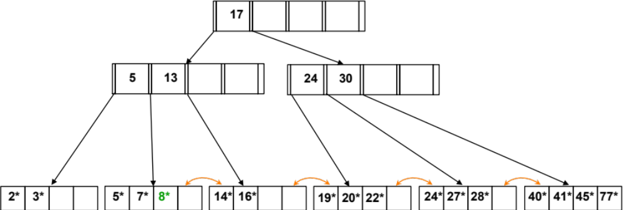
Exercise
Insert key 1 ?
Insert key 50 ?

Slide 47
B-Tree Deletion

Slide 48
Deleting a Data Entry from a B+ Tree
Start at root, find leaf L where entry belongs. (Searching)
Remove the entry.
  If L is at least half-full, done!
  If L has only the minimum entries,
    Try to re-distribute, borrowing from sibling (adjacent node with same parent as L).
    If re-distribution fails, merge L and sibling.
If merge occurred, must delete entry (pointing to L or sibling) from parent of L.
Merge could propagate to root, decreasing height.
Notes:
14

Slide 49
Example Tree: Delete 19*
Root
17
5
13
24
30
2*
3*
5*
7*
8*
14*
16*
19*
20*
22*
24*
27*
29*
33*
34*
38*
39*
Delete 19* is easy. Why?
  The leaf node has more than the minimum

Slide 50
Example Tree: After 19* was deleted
Root
17
5
13
24
30
2*
3*
5*
7*
8*
14*
16*
20*
22*
24*
27*
29*
33*
34*
38*
39*
What else did you observe?
  Very important in practice…
The other keys have shifted…
  Remember: empty spaces should be at the end only

Slide 51
Example Tree: Delete 20*
Root
17
5
13
24
30
2*
3*
5*
7*
8*
14*
16*
22*
24*
27*
29*
33*
34*
38*
39*
After the deletion the 4th node has below the minimum occupancy !!!
Need to re-distribute! How?

Slide 52
Example Tree: Delete 20*
Root
17
5
13
24
30
2*
3*
5*
7*
8*
14*
16*
22*
24*
27*
29*
33*
34*
38*
39*
Need to re-distribute! How?
  Check either of the two siblings
  Can you borrow from either of them without violating the min occupancy requirements?

Slide 53
Example Tree: Delete 20*
Root
17
5
13
24
30
2*
3*
5*
7*
8*
14*
16*
22*
24*
27*
29*
33*
34*
38*
39*
Need to re-distribute! How?
  Copy 24* into the sibling node (page).
Are we done??

Slide 54
Example Tree: Delete 20*
Root
17
5
13
27
30
2*
3*
5*
7*
8*
14*
16*
22*
24*
27*
29*
33*
34*
38*
39*
Need to re-distribute! How?
  Copy 24* into the sibling node (page).
  Copy key 27 into the parent node (page).

Slide 55
Deleting 19* and 20* ...
Root
17
5
13
27
30
2*
3*
5*
7*
8*
14*
16*
22*
24*
27*
29*
33*
34*
38*
39*
Notice how middle key is copied up.
  What else have we done?
    Record organization in a page matters for a B⁺-tree!
Notes:
15

Slide 56
Deleting 24* ...
Root
17
5
13
27
30
2*
3*
5*
7*
8*
14*
16*
22*
24*
27*
29*
33*
34*
38*
39*
Borrow from a sibling will not work !!!
Notes:
15

Slide 57
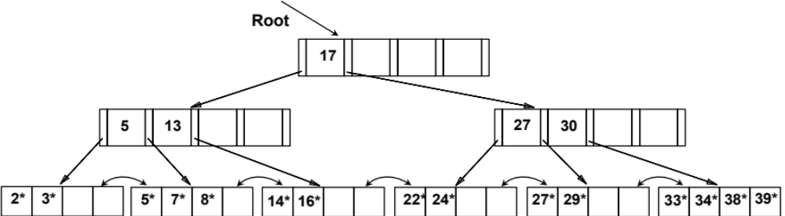
Deleting 24* ...
Must merge.
30
22*
27*
29*
33*
34*
38*
39*
Notes:
16

Slide 58
Deleting 24* ...
Must merge.
30
22*
27*
29*
33*
34*
38*
39*
Root
5
13
17
30
2*
3*
5*
7*
8*
14*
16*
22*
27*
29*
33*
34*
38*
39*
Notes:
16

Slide 59

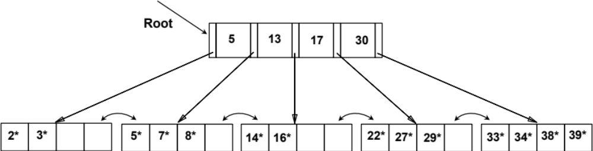
Deleting 24* ...
Notice:
When merging internal nodes…you get back the key that you passed to the parent
Notes:
16

Slide 60
Deleting 24* ...
Notice:
Deletion still keep the tree balanced
Notice:
The tree height may be reduced
Notes:
16

Slide 61
Back to Deletion Algorithm
Start at root, find leaf L where entry belongs. (Searching)
Remove the entry.
  If L is at least half-full, done!
  If L has only the minimum entries,
    Try to re-distribute, borrowing from sibling (adjacent node with same parent as L).
    If re-distribution fails, merge L and sibling.
If merge occurred, must delete entry (pointing to L or sibling) from parent of L.
Merge could propagate to root, decreasing height.
Notes:
14

Slide 62
More Practical Deletion:
Deleting 24* ...
Root
17
5
13
27
30
2*
3*
5*
7*
8*
14*
16*
22*
24*
27*
29*
33*
34*
38*
39*
When deleting 24*, allow its node to be under utilized
After some time with more insertions
  Most probably more entries will be added to this node
If many nodes become under utilized ➔ Re-build the index
Notes:
15

